Slide 1

Amazon lookout for vision

Slide 2
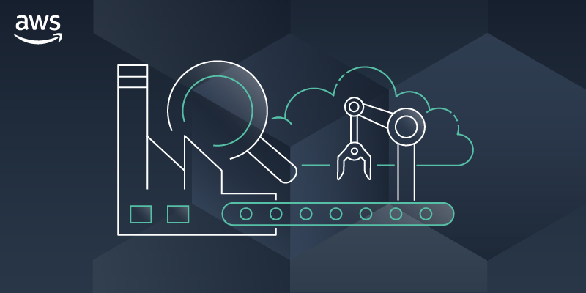

Agenda
Introduction
Use Cases
How It Works
Implementation

Slide 3
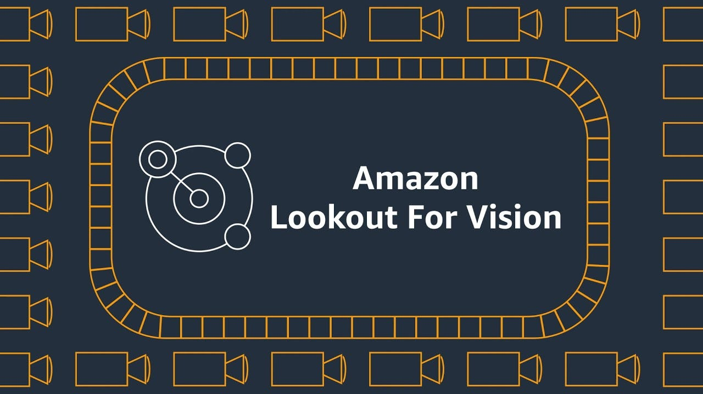
Introduction :
Amazon Lookout for Vision is a cloud-based service. It is a machine learning technology to enable precise object detection and anomaly detection within images.
It helps computers recognize things in pictures, like finding objects or spotting anything unusual(like product defects to automate quality inspection).

Slide 4
Use cases :
Manufacturing Quality Control
Anomaly Detection in Industrial Processes
Defect Detection in Products
Automated Optical Inspection (AOI)
Healthcare Imaging
Document Verification
Agricultural Monitoring

Slide 5
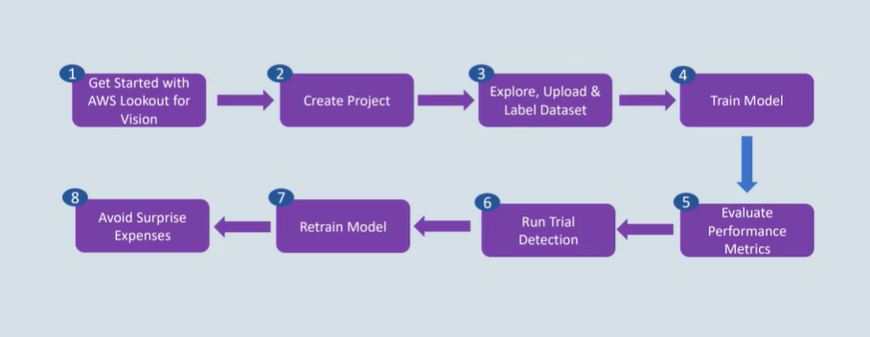
How It Works :

Slide 6
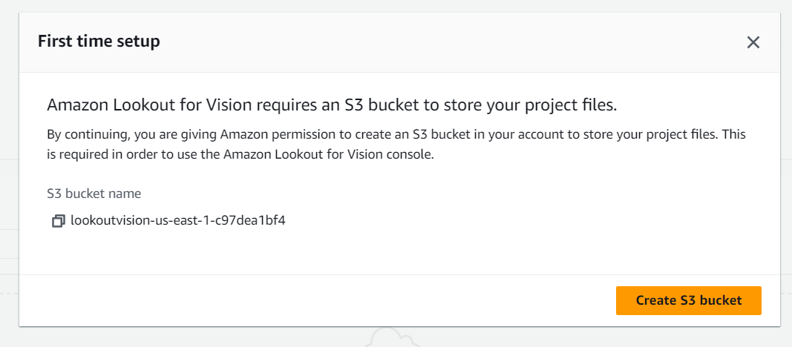
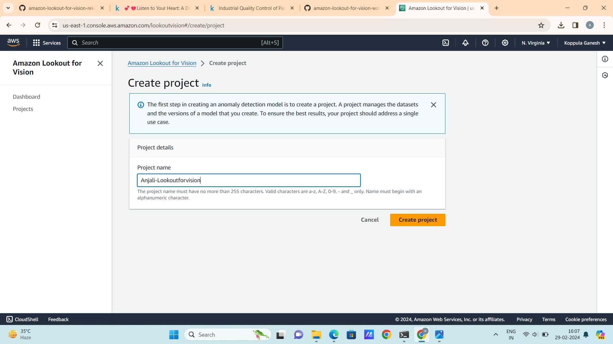
Implementation :
1. Create a Project

Slide 7
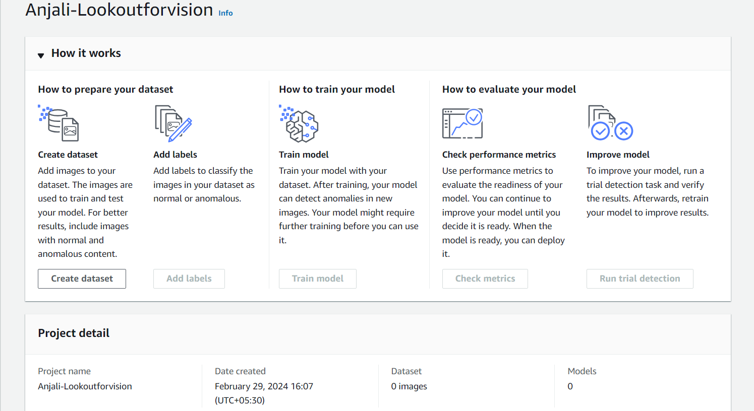
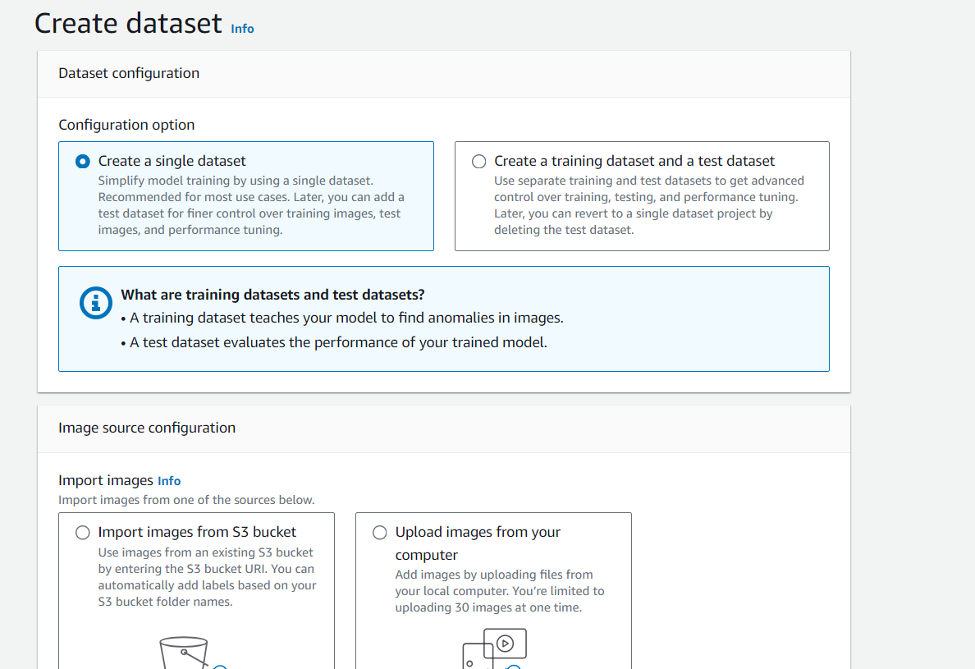

Slide 8
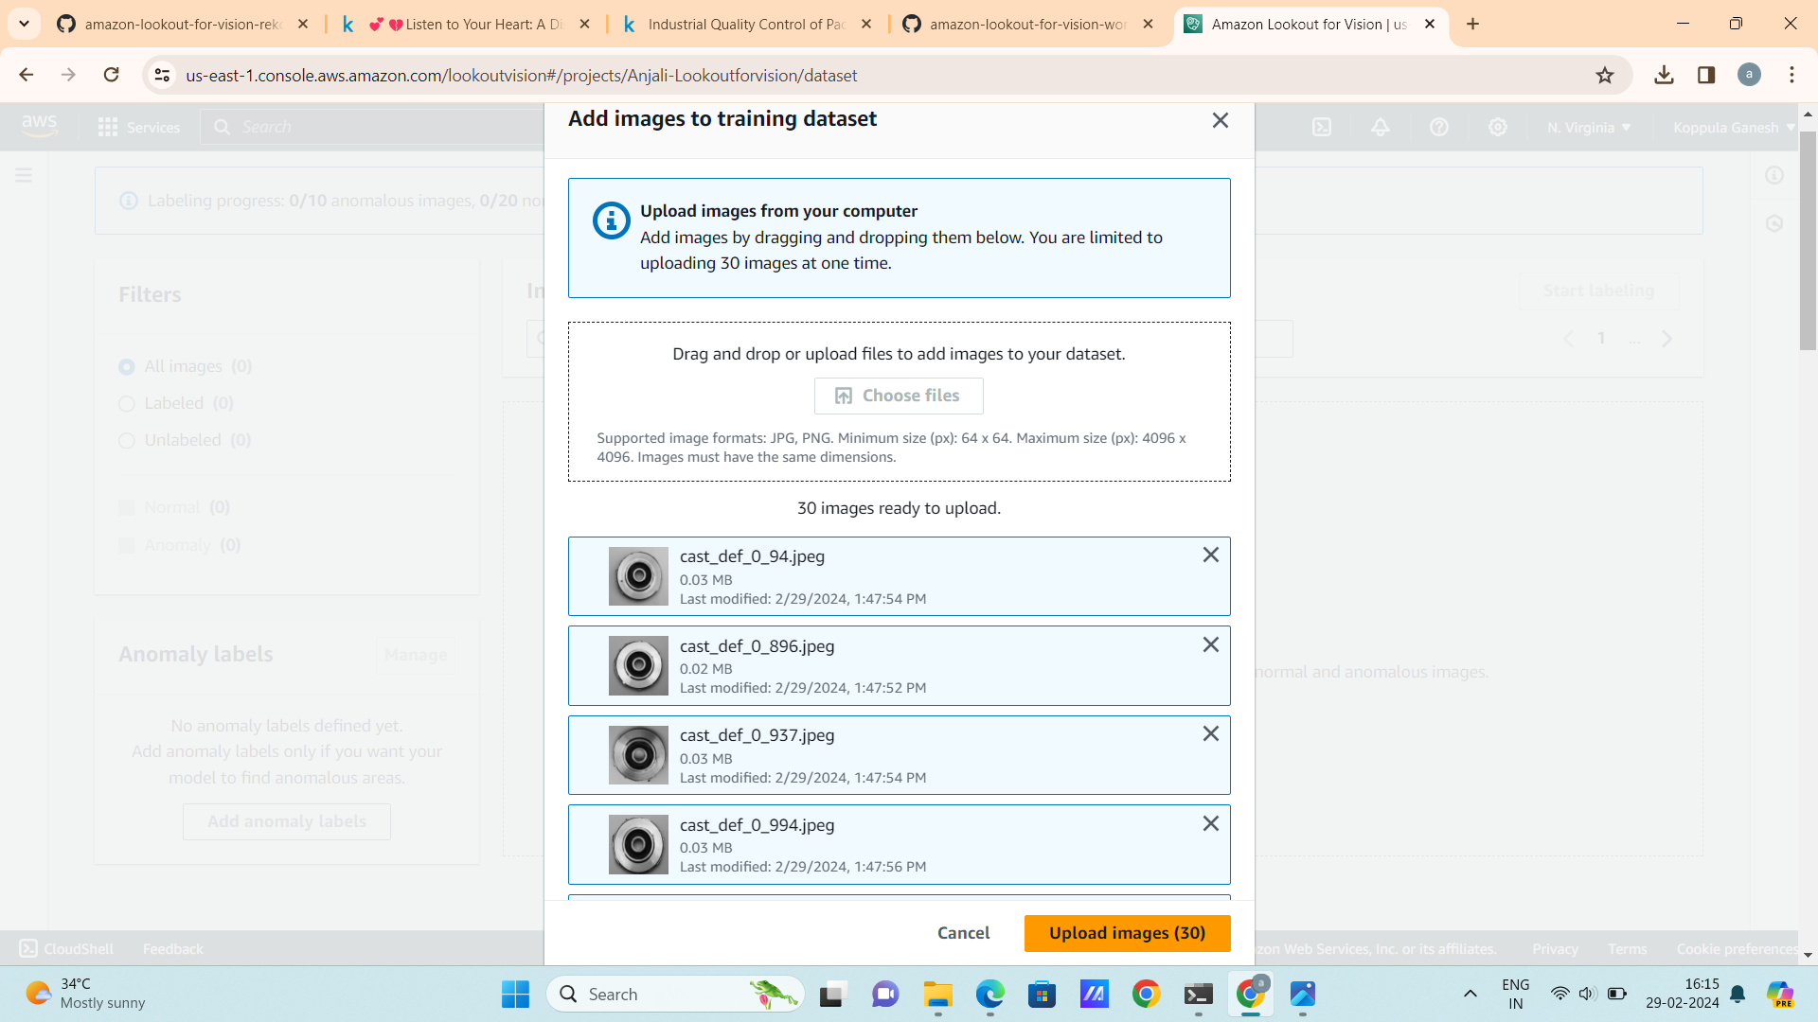
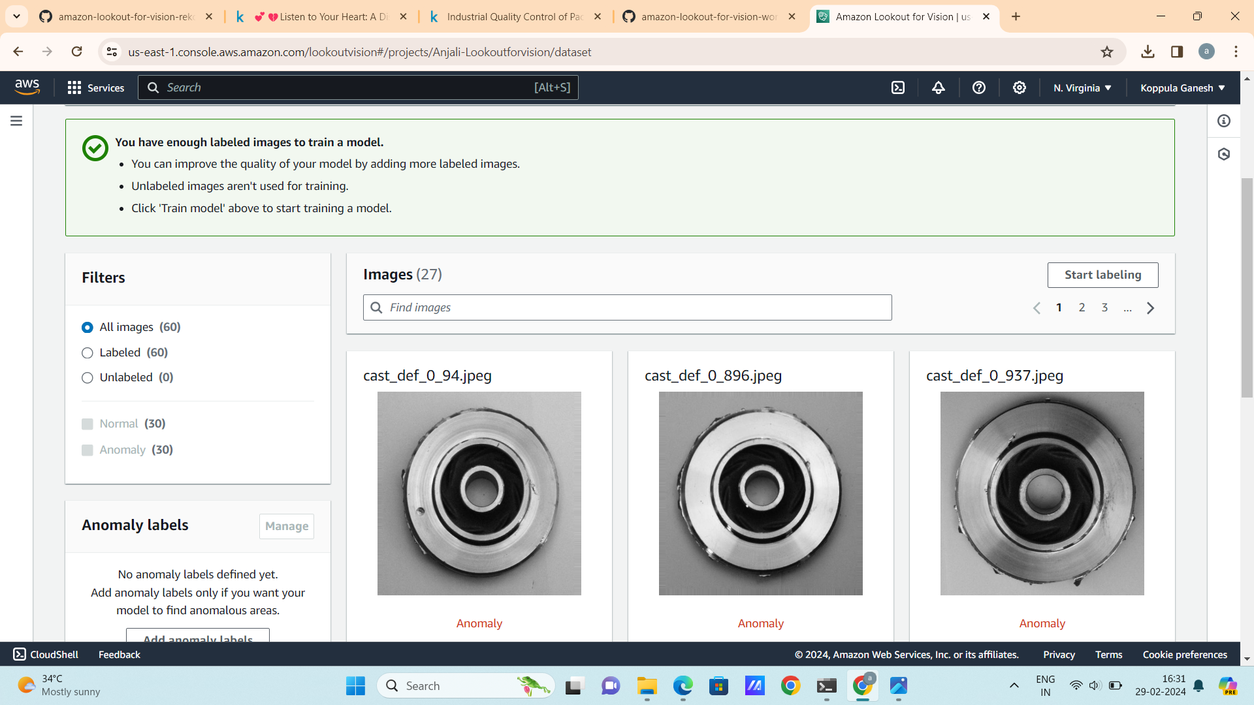
2. Explore Upload and Label Dataset

Slide 9
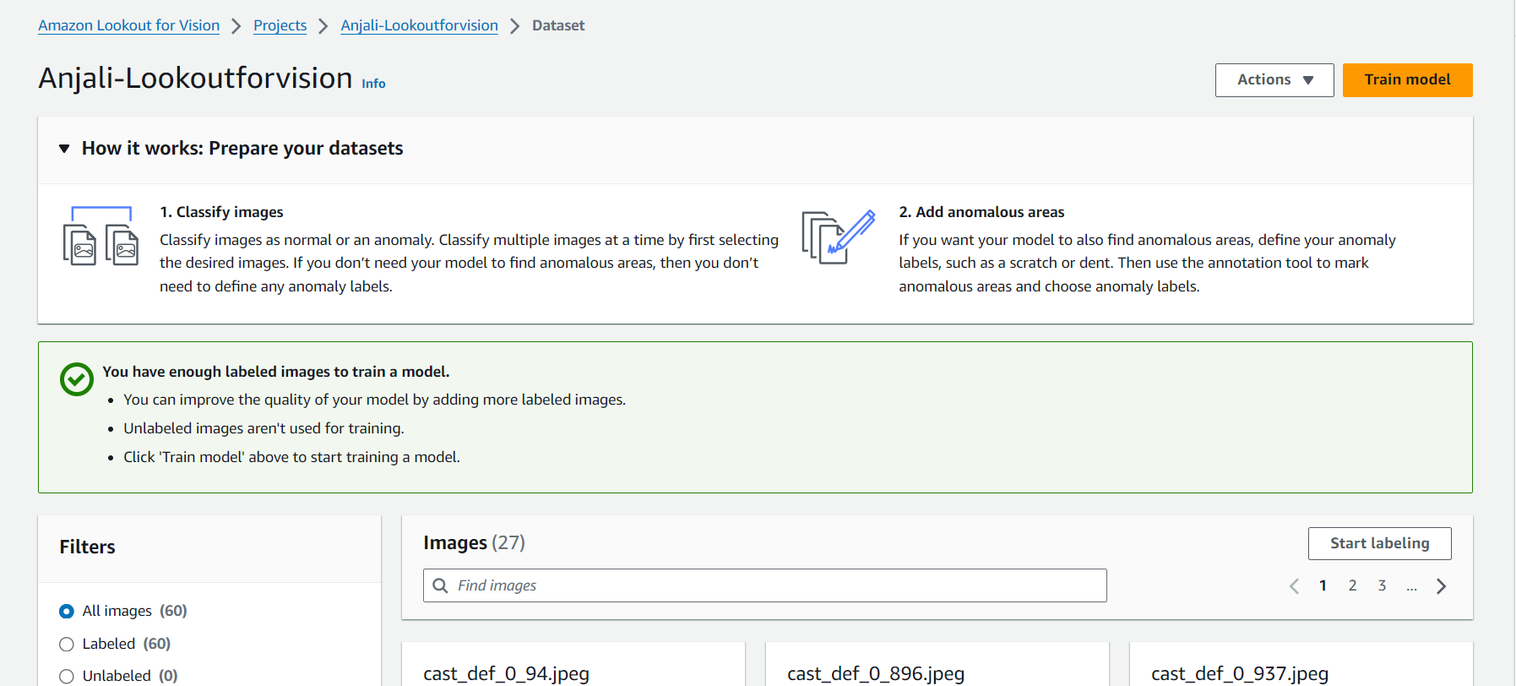
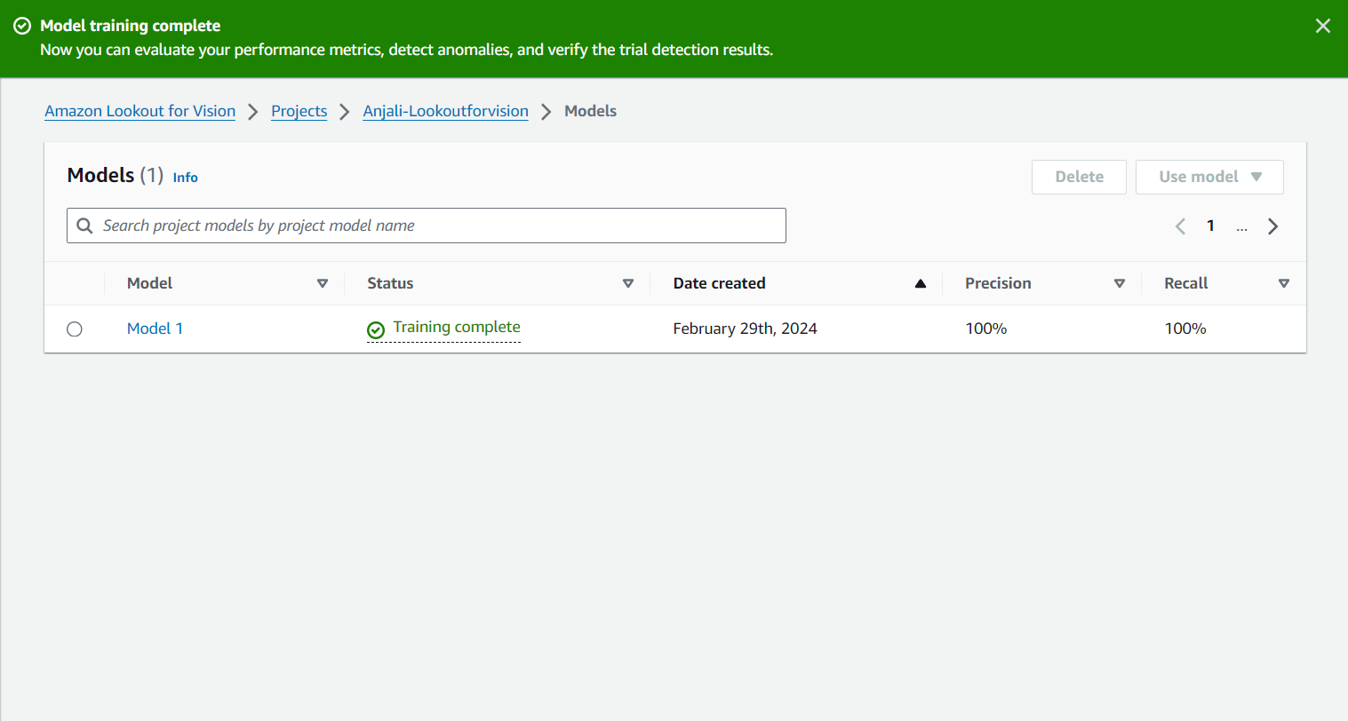
3. Train the model

Slide 10
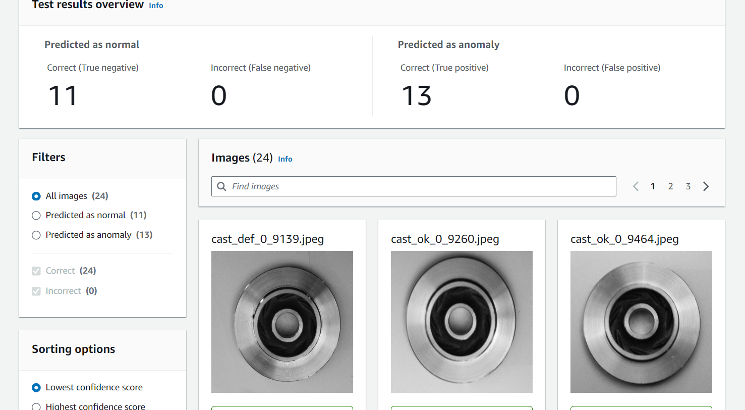

Slide 11
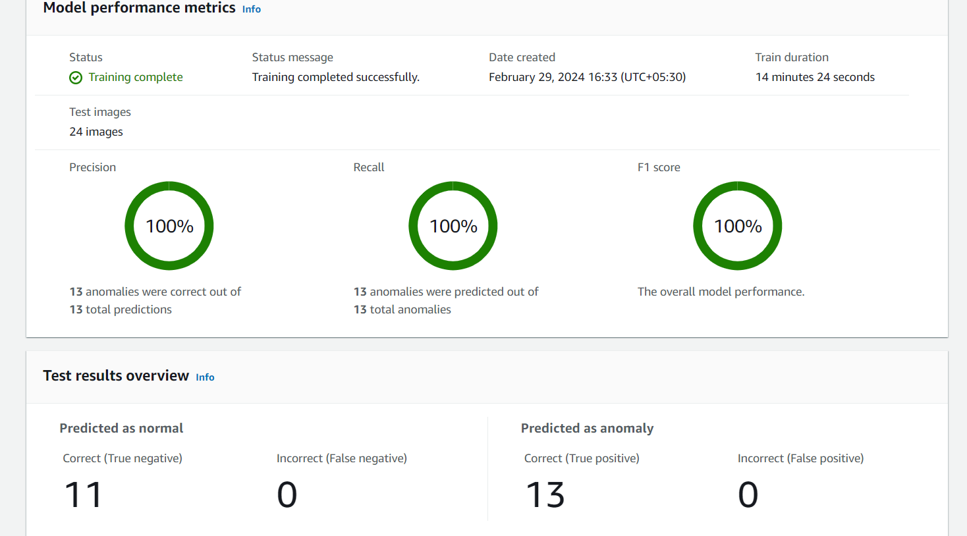
4. Evaluate Performance Metrics

Slide 12
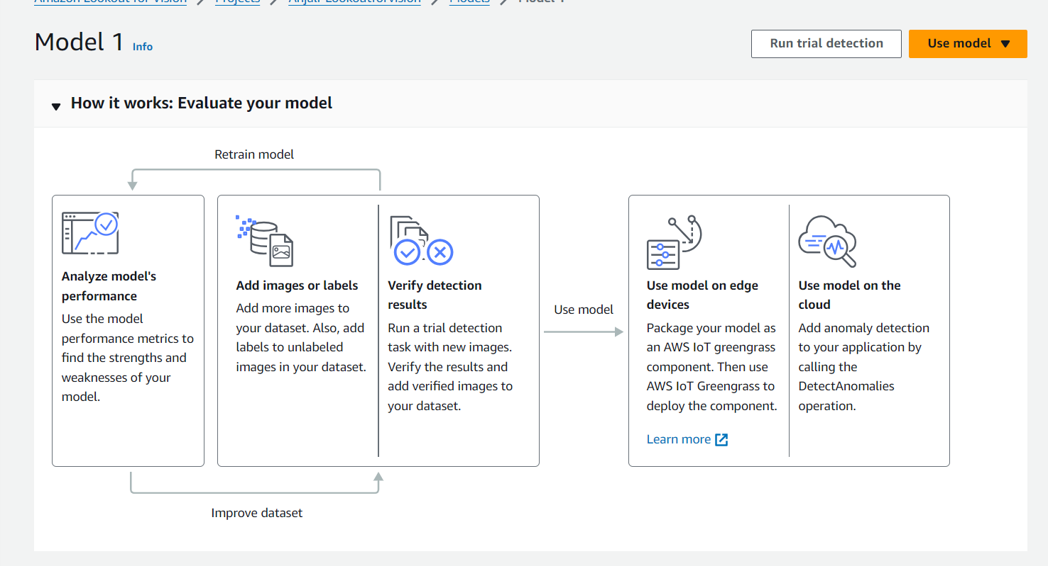
5. Run Trial Detection

Slide 13
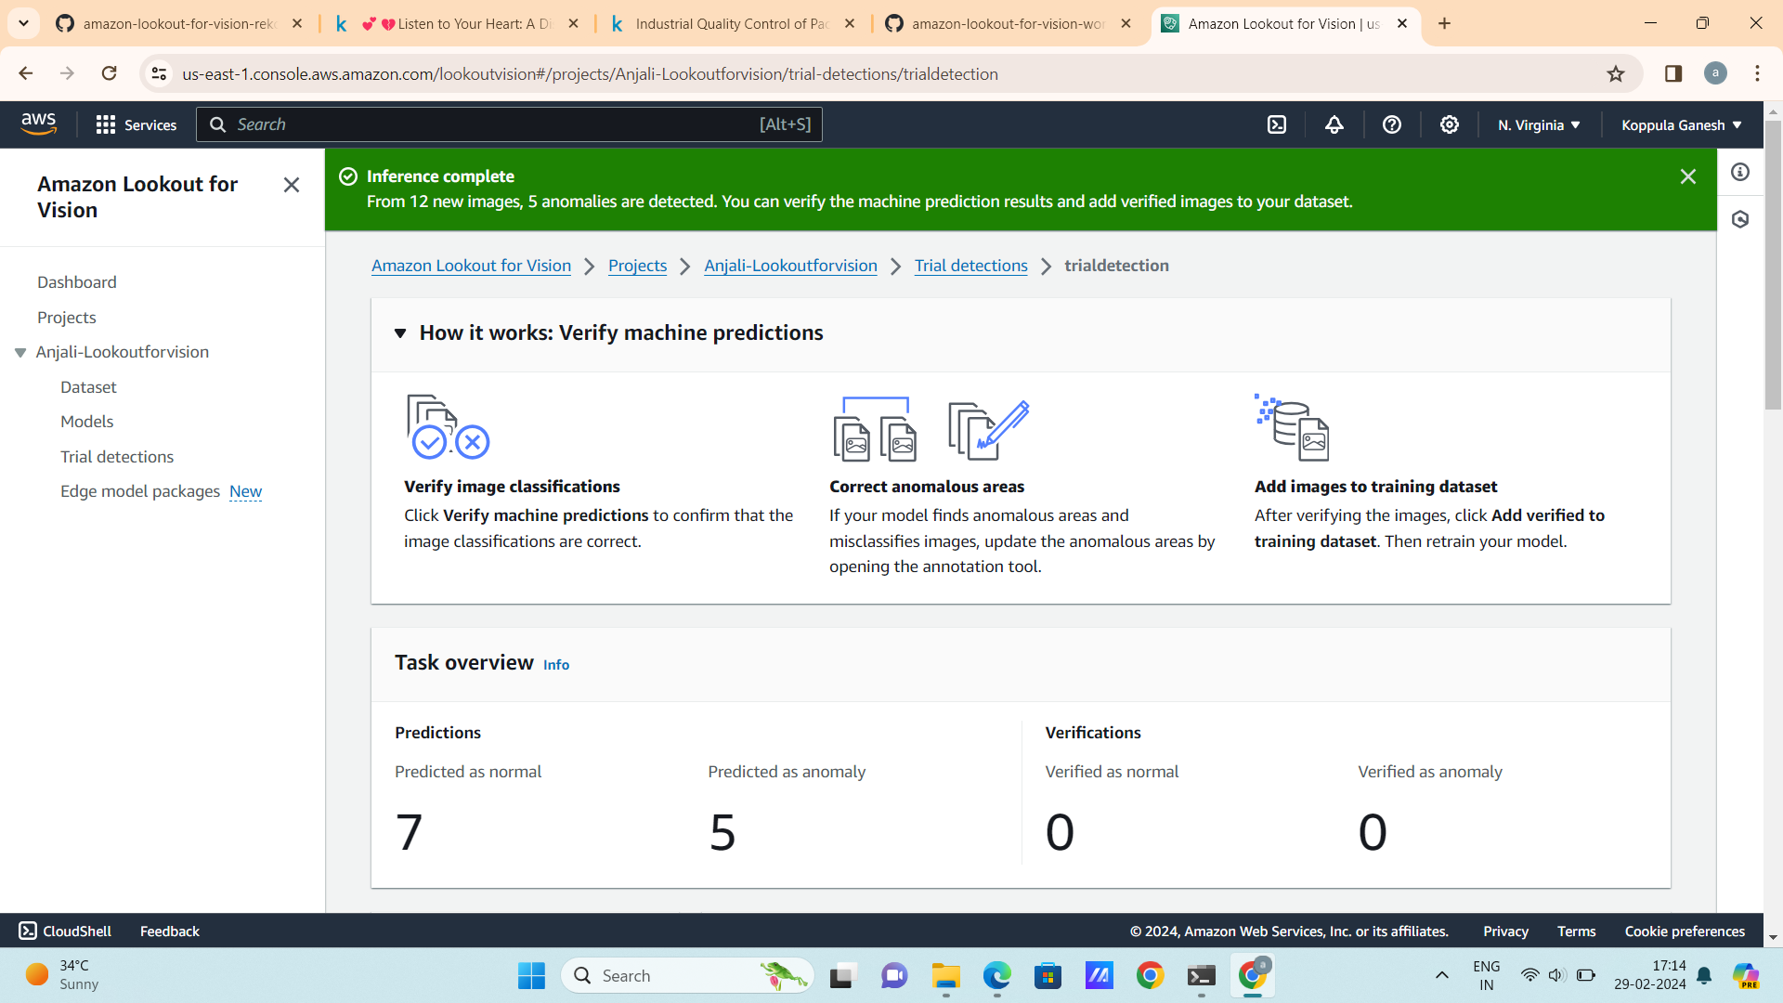

Slide 14
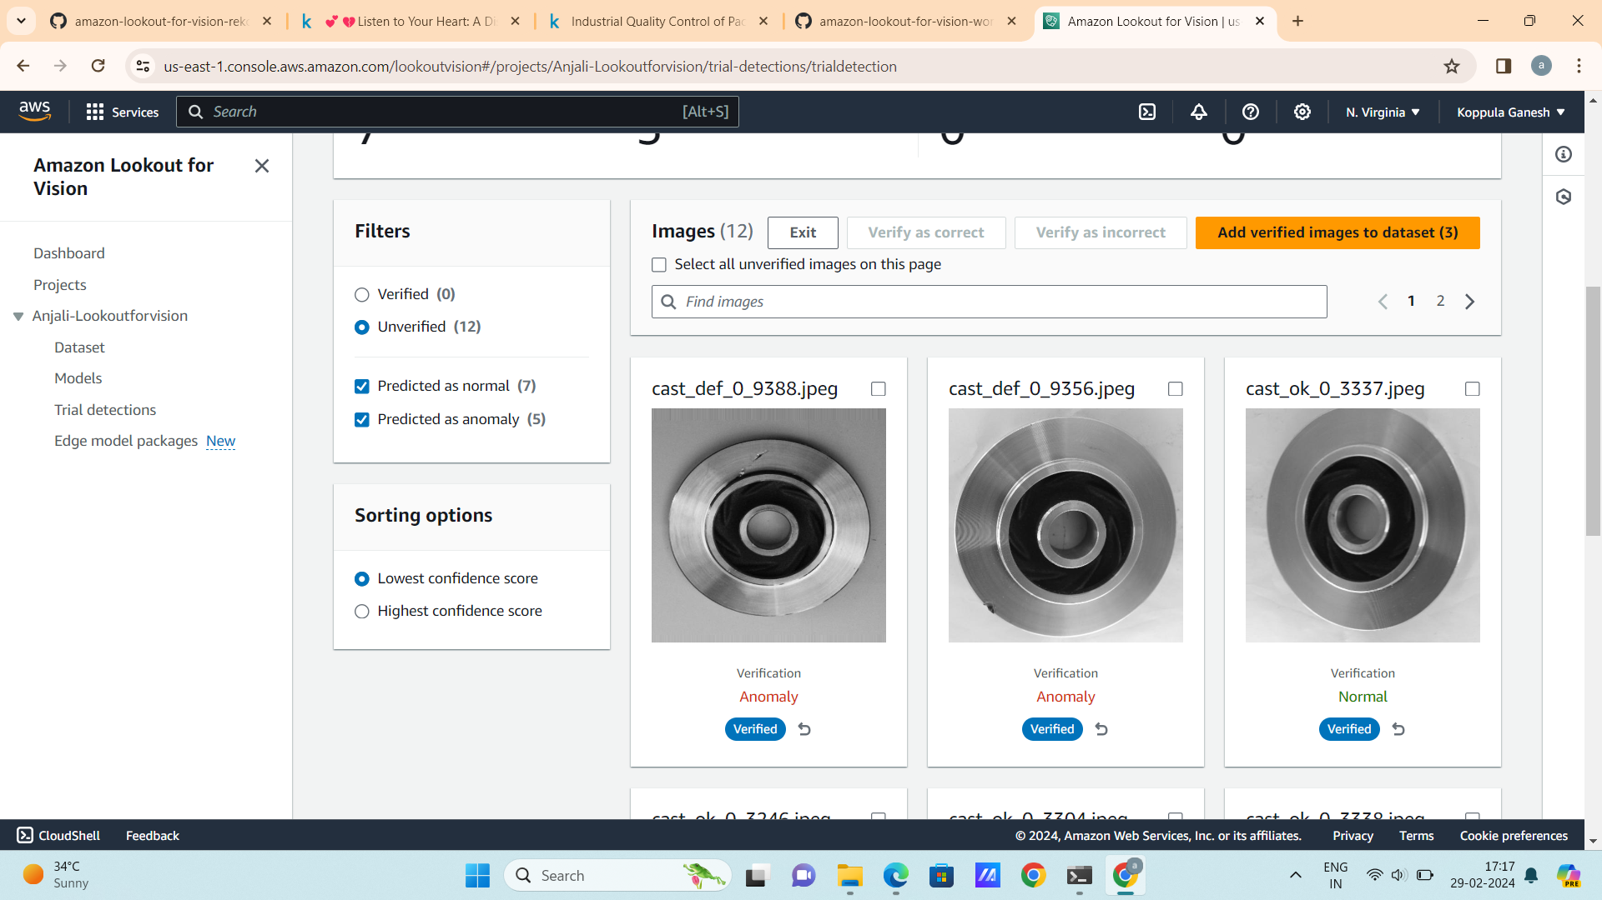

Slide 15
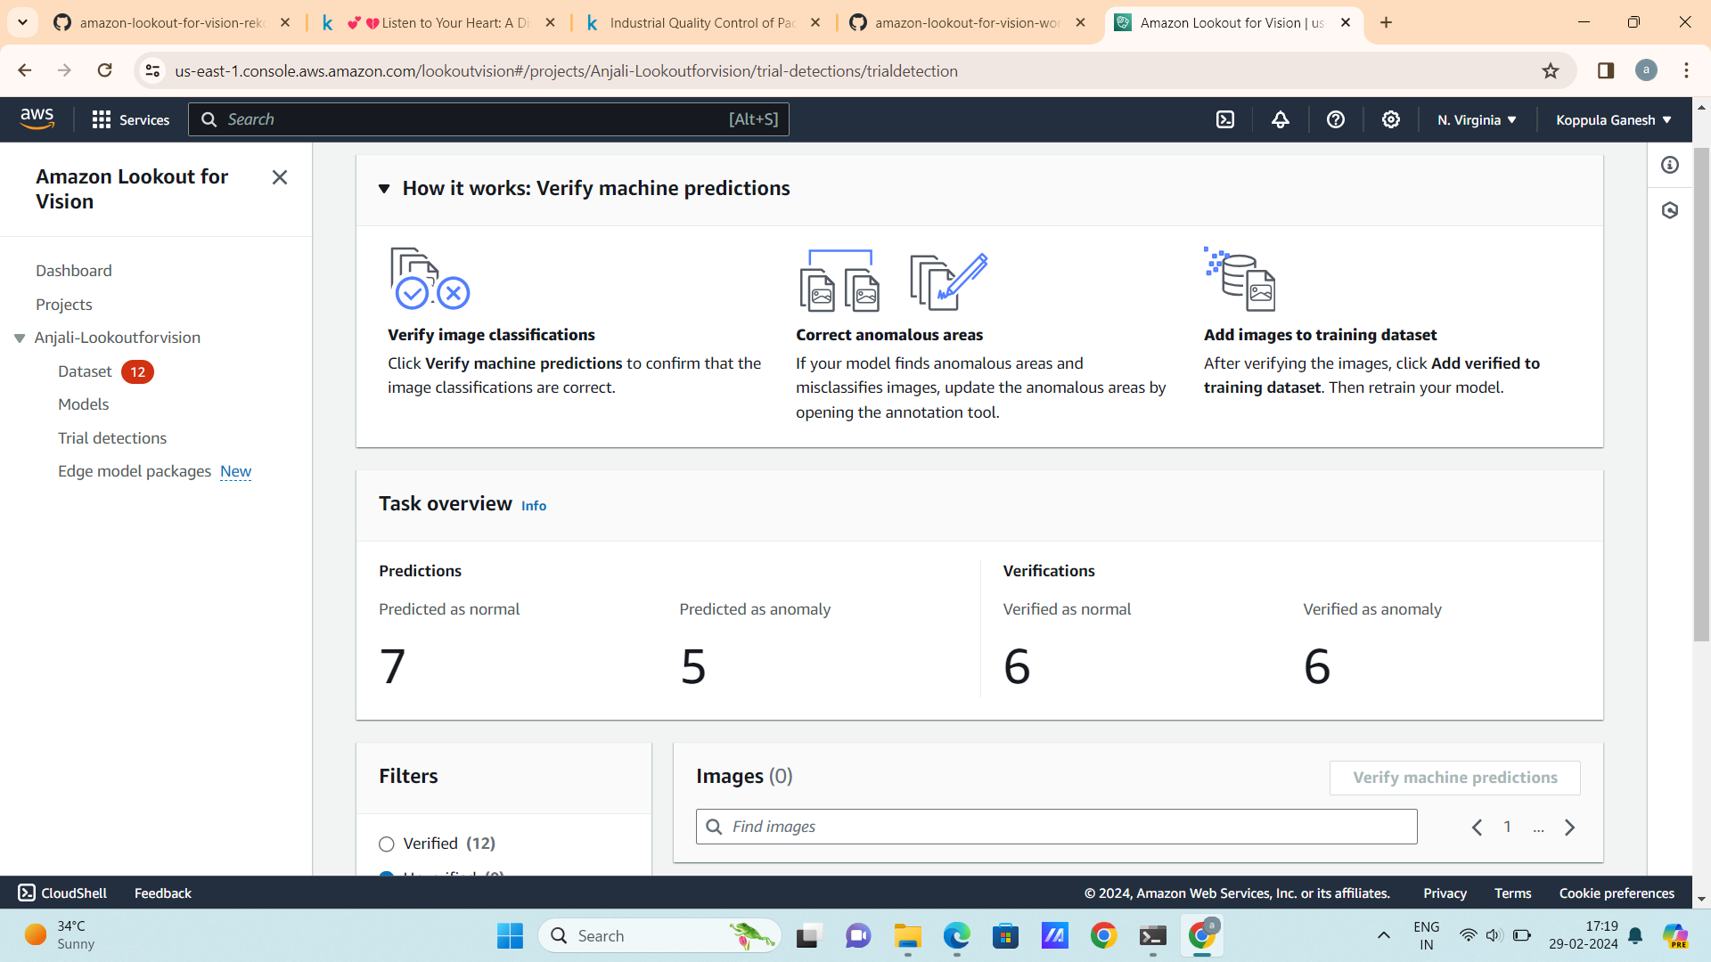

Slide 16
Thank You

